Slide 1
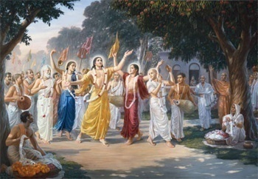
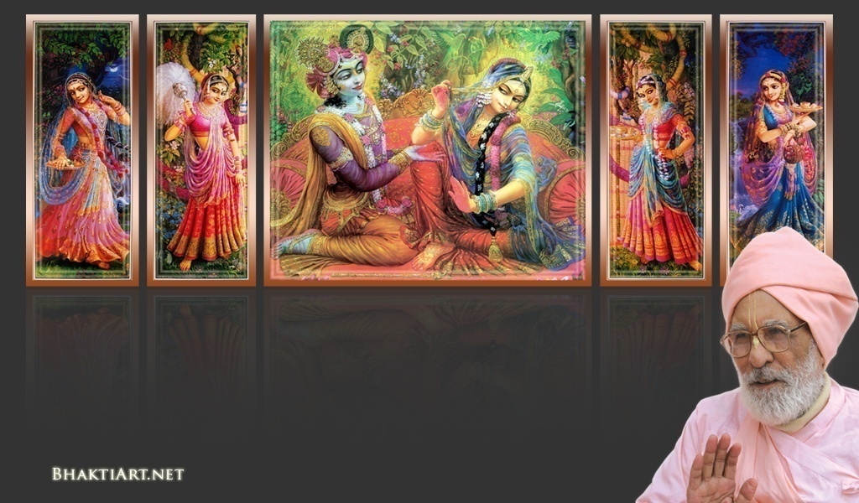
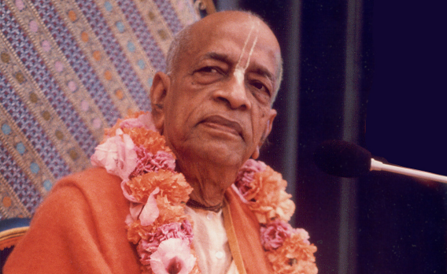
Sri Krsna Caitanya Prabhu Nityananda
Sri Advaita Gadadara Srivasadi
Gaura Bhakta Vrinda
Week# 250
Jan 18, 2013
Hare Krsna Hare Krsna
Krsna Krsna Hare Hare
Hare Rama Hare Rama
Rama Rama Hare Hare
Gokul Bhajan & Vedic Studies
North Carolina, USA
Notes:
Om Ajnana timirandhasya, jnananjana salakaya
Caksur unmimiltam yena, tasmai sri gurave namah
Namah om vishnu padaya, radhikayah priyatmane
Sri-srimad bhaktivedanta, narayana iti namine
Sri krishna lila kathane sudaksham
Audarya-madhurya gunais ca yuktam
Varam varenyam purusham mahantam
Narayanam tvam sirasa namami
He krishna karuna sindho, dina bandho jagat pate
Gopesha gopika kanta, radha kanta namo ‘stu te
tapta kancana gaurangi, radhe vrindavaneshvari
vrsabhanu sute devi, pranamami hari priye
bhajami radham aravinda netram
smarami radham madhurasmi-tasyam
vadami radham karuna bharardram
tato mam anyasti gatir na kapi
bhaktya vihina aparadha lakshai
ksiptas ca kamadi taranga madhye
krpamayi tvam saranam prapanna
vrinde numas te caranara vindam

Slide 2
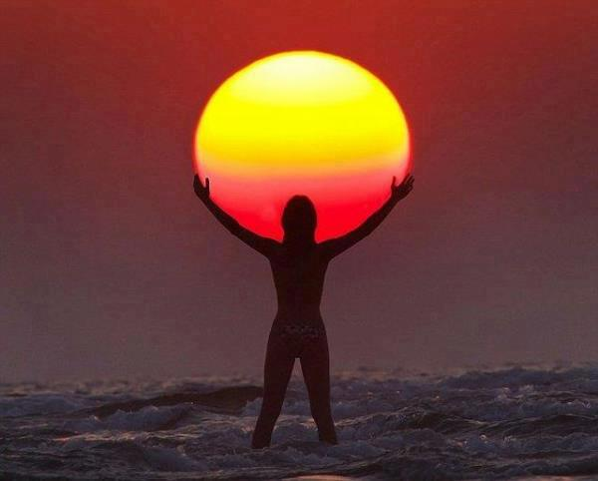
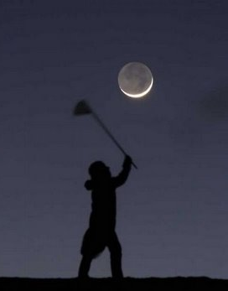
Week# 250
Jan 18, 2013
Catching ?!

Slide 3
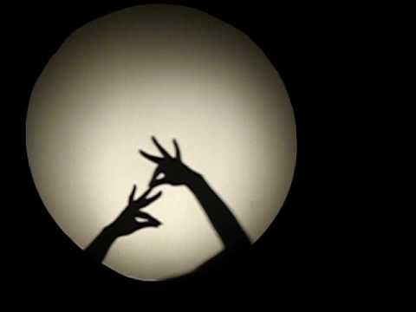
How many of you are good at this ?

Slide 4
A Tiger!

Slide 5
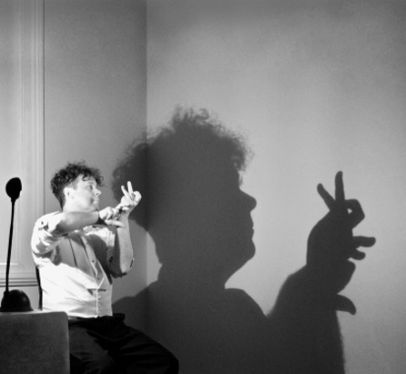
A rabbit!

Slide 6
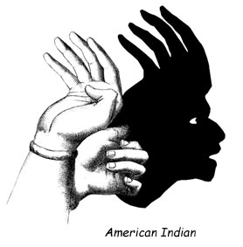
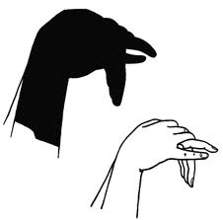
Wow!

Slide 7
How many of you have tried catching your own shadows?

Slide 8
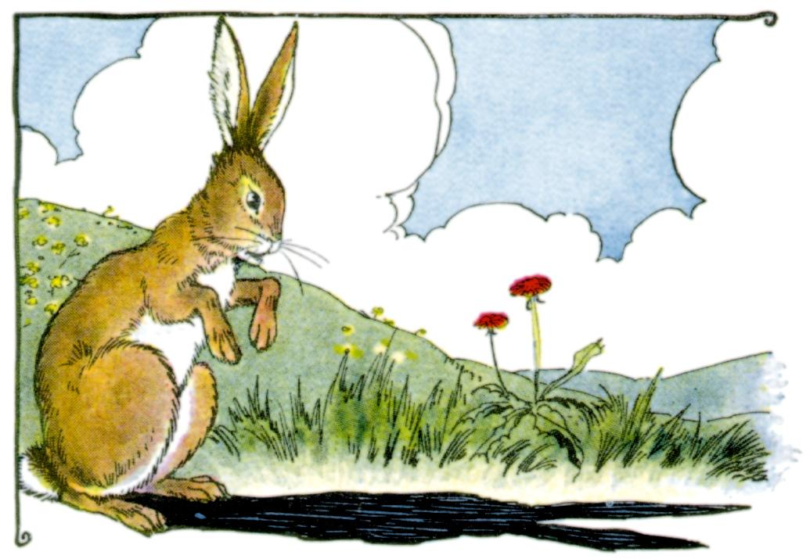
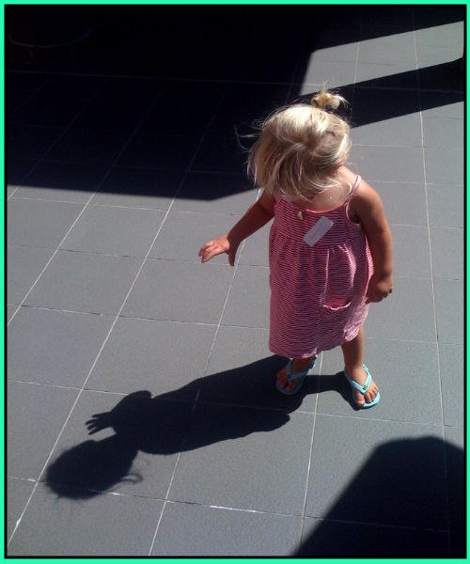

Slide 9
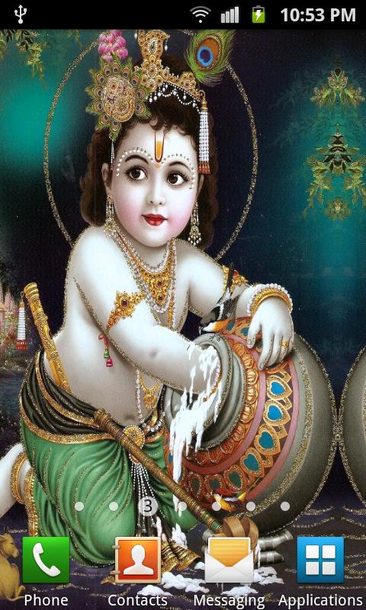
One day, Krishna was playing in the courtyard in Gokul

Slide 10
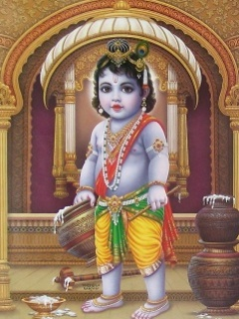
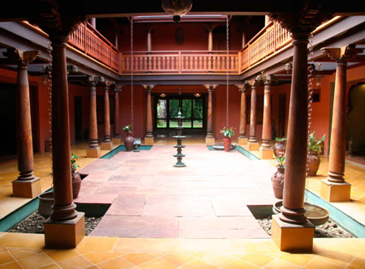
G1-05
Kinkinî valaya nūpura dhāri
Niśka kundala varāngada hārî
Pîta cîna vasanah sa-dimbhah
Sinjitair api manāmsi jahāra
(Aiswarya Kadambini 6.8)
Dressed in yellow silk and decorated with bracelets, anklets, necklaces, splendid armlets, and golden earrings, child Krishna stole everyone’s heart with the tinkling sounds he made as he walked.

Slide 11
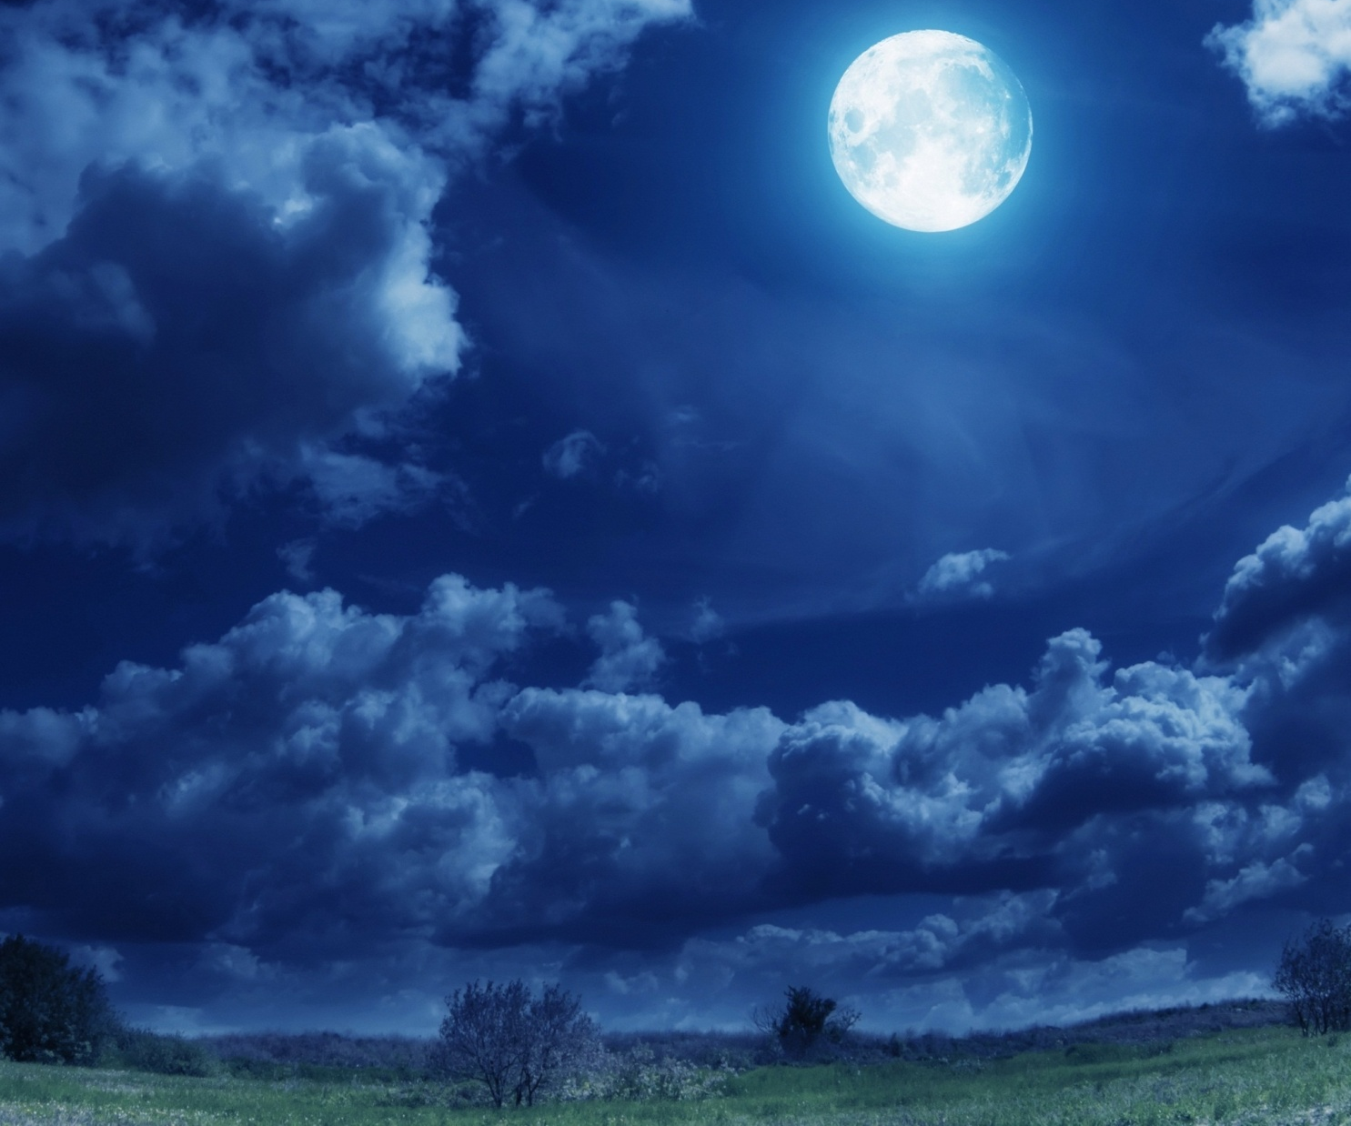

Slide 12
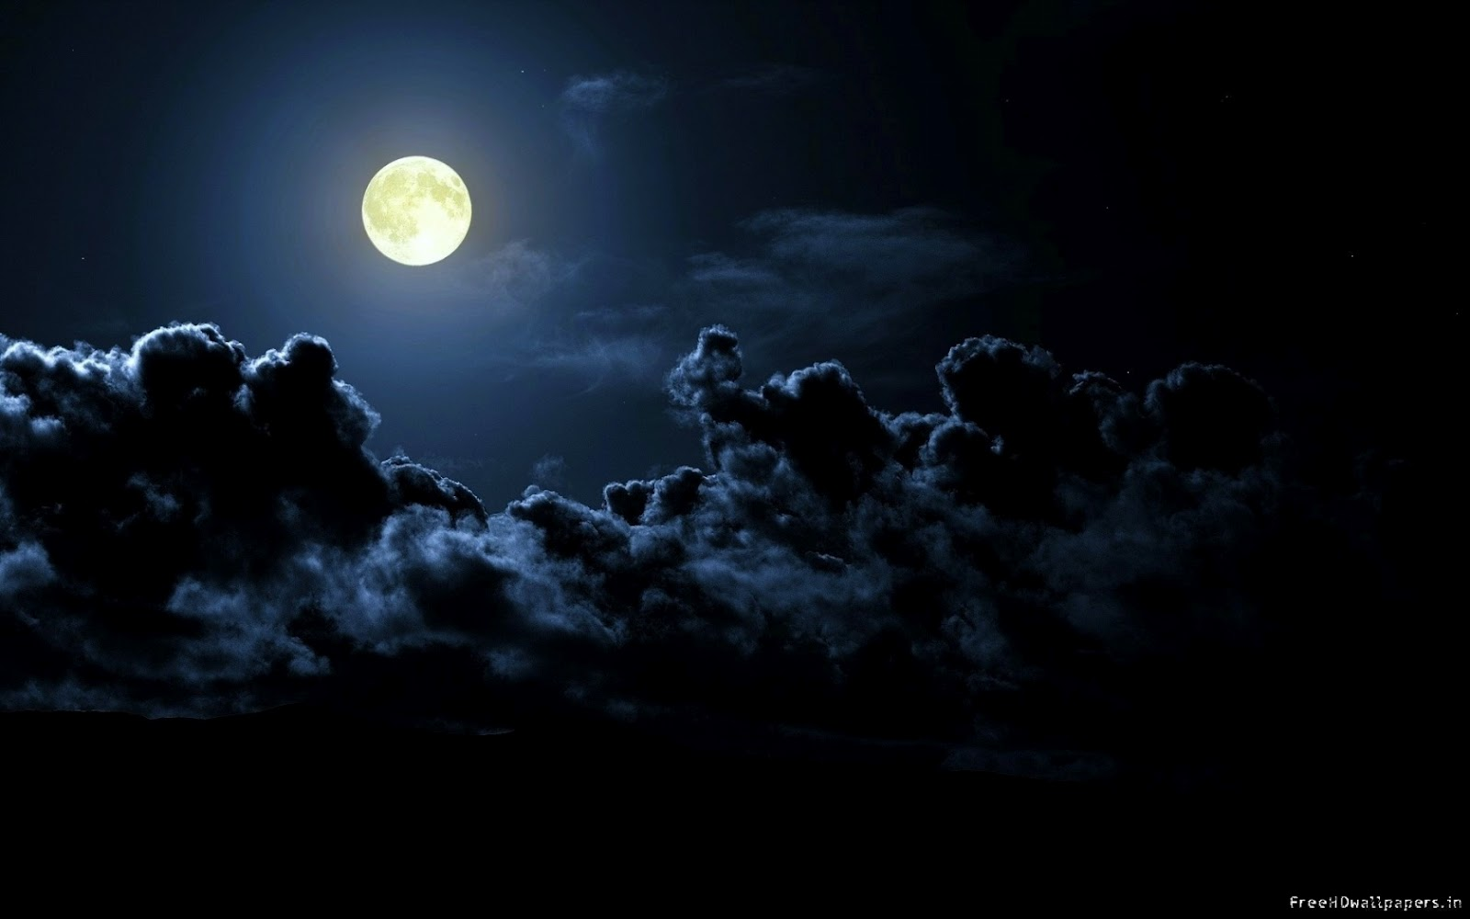

Slide 14
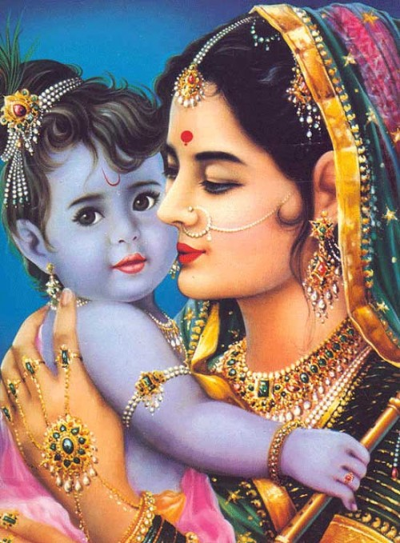
“How can you catch your shadow? It is not possible!”
“Yes Maiya! No one can catch even my shadow! Only you can catch Me maiya!”

Slide 15
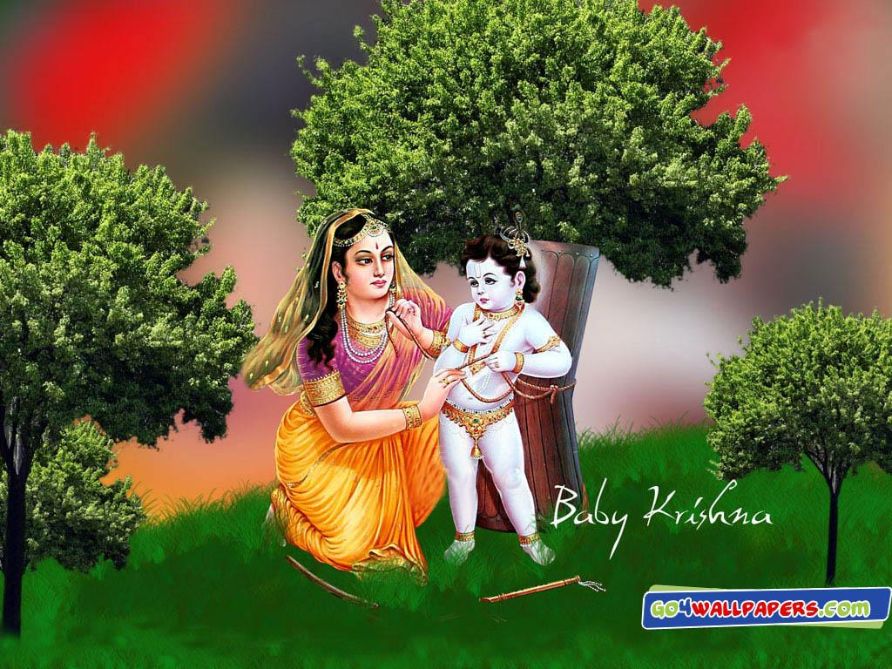
Who can catch Krishna?

Slide 16
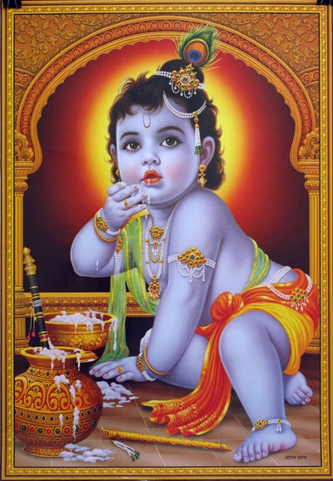
D-54
[Ezhayaagum ennodinga yenbinaa
Unni kanna Itra yeru paribhavam]
[Kannu neer thoovi yenkavizhthadam
Kaazhindiyai maari kanna nikkavum]
Chorus:
Kanna kanna unni kanna aadi vaa
Kai niraya venna tharaam odi vaa
Peeli kanna maaya kanna odi vaa
Ponnoda kulaloothi odi vaa
…. (Ezhayagum-1)
1 of 4

Slide 17
[Ezhayaagum ennodinga yenbinaa
Unni kanna itra yeru paribhavam]
[Guruvayur puram vaazhum ishvaraa
Ennum ennum nee vizhigal kezhkane]
[Nin thiru paathangal yennam michidaa
Paviduthe kirtanangal paadidaa]
Chorus:
Hare krsna hare krsna paahi maam
Krsna krsna krsna hare paahi maam
Devaki nandanaa paahi Maam
Vasudeva vasudeva paahi maam
….(Ezhayagum-1)
2 of 4

Slide 18
[Ezhayaagum ennodinga yenbinaa
Unni kanna itra yeru paribhavam]
[Eerezhu pathinaalu logangazh
Avidutha thiruvaayil kandathu]
[Adiyengal aham pu(hu)nthu paadidum bo
Ambaadi kanna yen arugil vaa vaa]
Chorus:
Kanna kanna unni kanna aadi vaa
Kai niraya venna tharaam odi vaa
Peeli kanna maaya kanna odi vaa
Ponnoda kulaloothi odi vaa
3 of 4

Slide 19
[Ezhayaagum ennodinga yenbinaa
Unni kanna Itra yeru paribhavam]
[Kannu neer thoovi yenkavizhthadam
Kaazhindiyai maari kanna nikkavum]
Chorus (3 time to end):
Kanna kanna unni kanna aadi vaa
Kai niraya venna tharaam odi vaa
Peeli kanna maaya kanna odi vaa
Ponnoda kulaloothi odi vaa
4 of 4

Slide 20
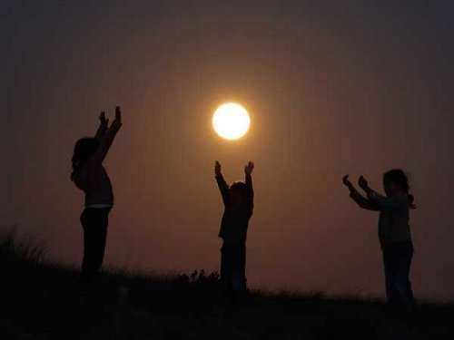
Every one in this world is trying to catch something!

Slide 21
Every one wants to be happy all the time..!

Slide 22
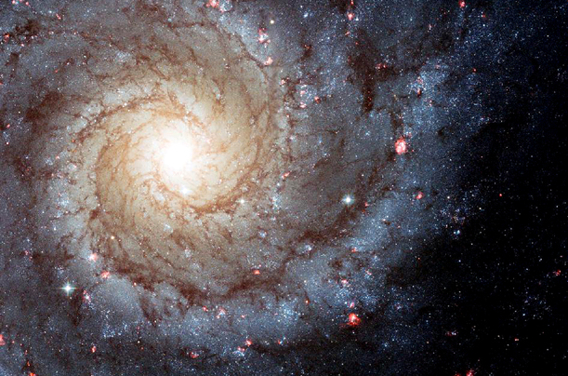
The same thing is going on in the innumerable universes managed by innumerable Brahmas..

Slide 23
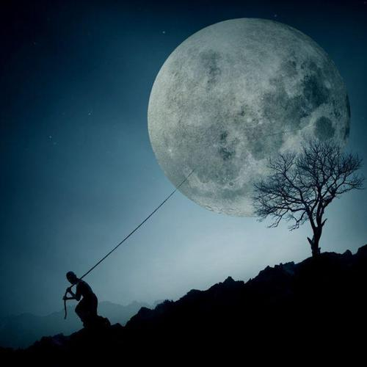
They try so hard and so hard to catch that… What is it?

Slide 24
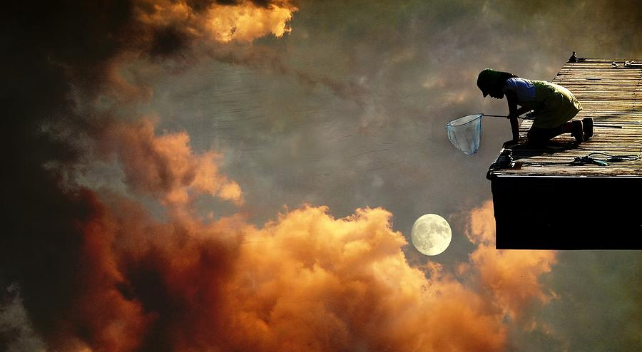
Every one is trying to catch the happiness!
Can they really catch it?

Slide 25
For catching happiness…
one marries..

Slide 26
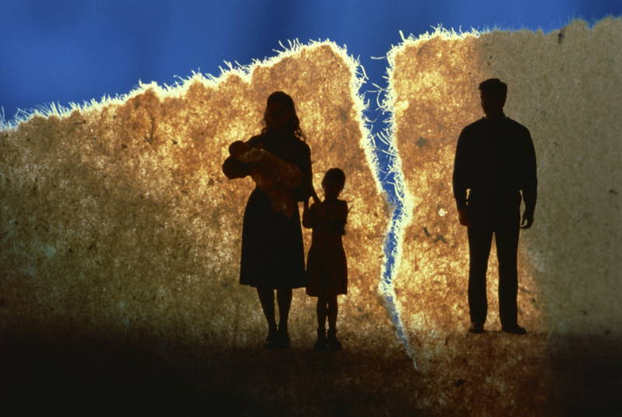
For catching happiness..
One dumps own dears!

Slide 27
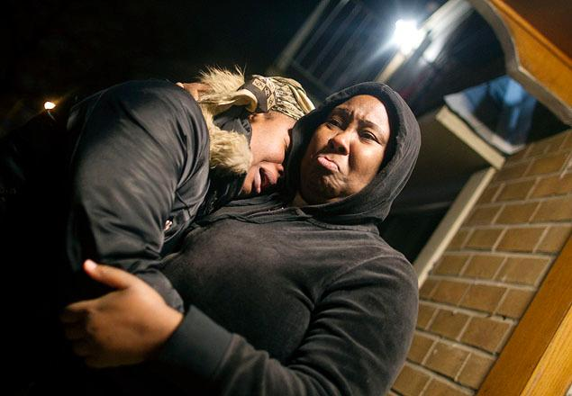
For catching that happiness..
One even kills another!

Slide 28
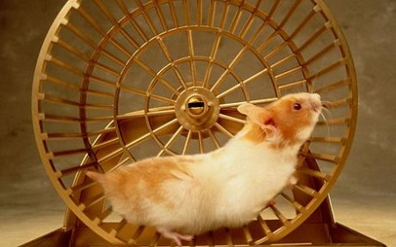
Everyone tirelessly works very hard to get THAT happiness..

Slide 29
There is no ending of this rat race!

Slide 30
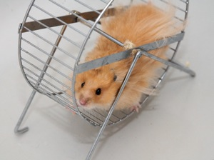
When frustrated, they take a break!
But they resume the very same thing again due to Maya.

Slide 31
Days, months and Years go by..
And time comes to leave the world!

Slide 32
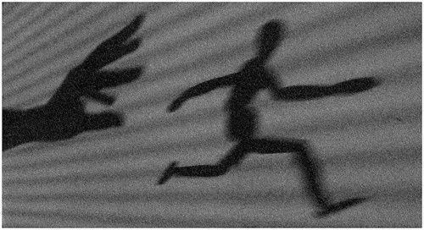
What happened to the happiness they tried to catch?

Slide 33
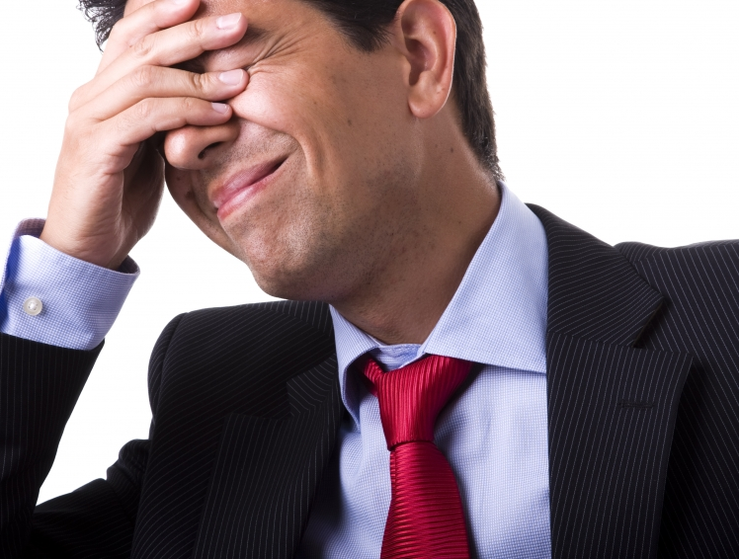

Slide 34
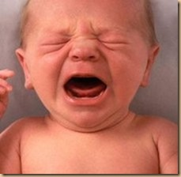
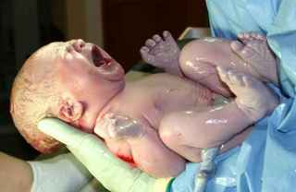
When we came here as babies, we came crying..
Did any of you were born smiling and laughing in happiness ?

Slide 35
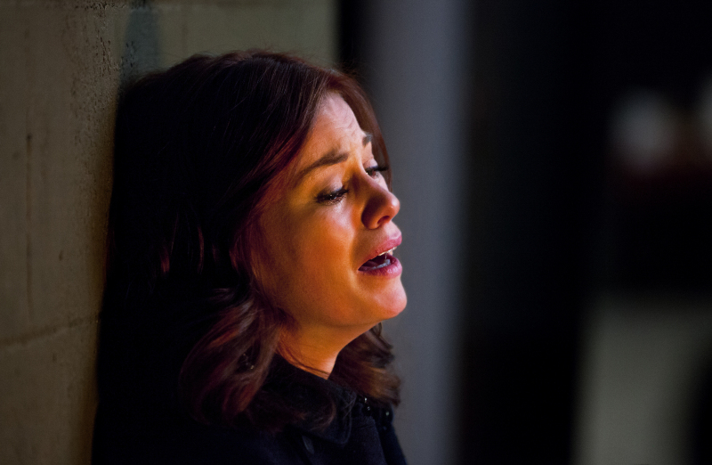
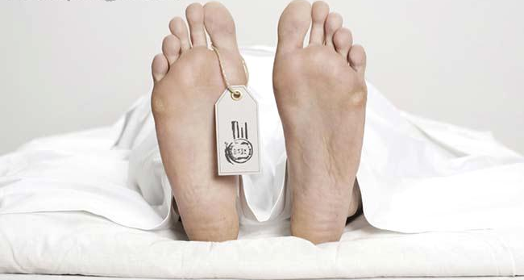
When we are born, we cry;
When we die, others cry!

Slide 36
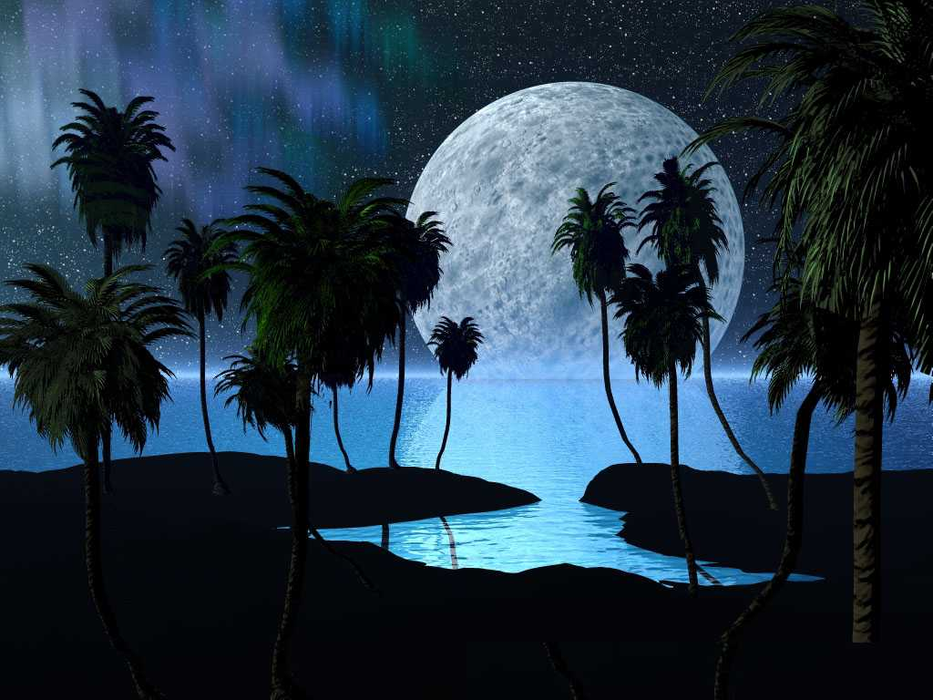
There are two kinds of happinesses..
Para Sukha
Apara Sukha
Krishna says that the material worlds are Dukha Alaya.. There is only sorrows..

Slide 37
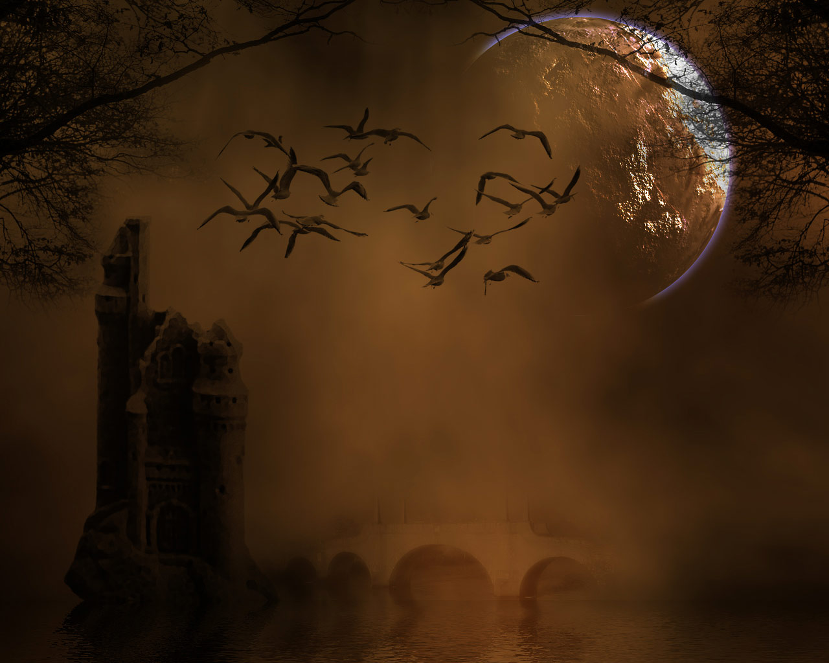
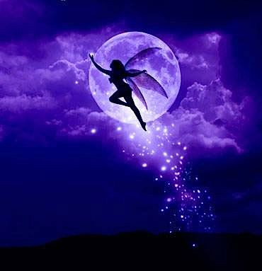
Where is para sukha?
It is only in the spiritual world.
There are many levels of happiness.

Slide 38
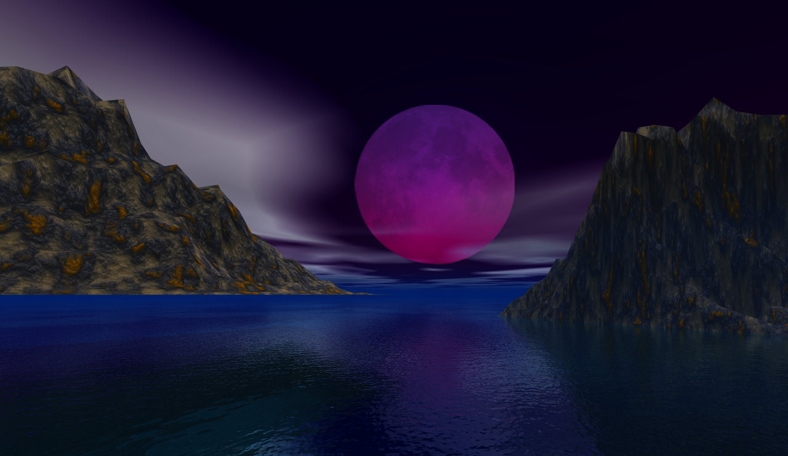
Planes of Happiness
Lower Lokas & Pitra Loka
Middle Lokas & Heaven
Deva Lokas upto Brahma Loka
Brahman
Abhodes of Krishna’s Expansions
Abhode of Sri Krishna

Slide 39
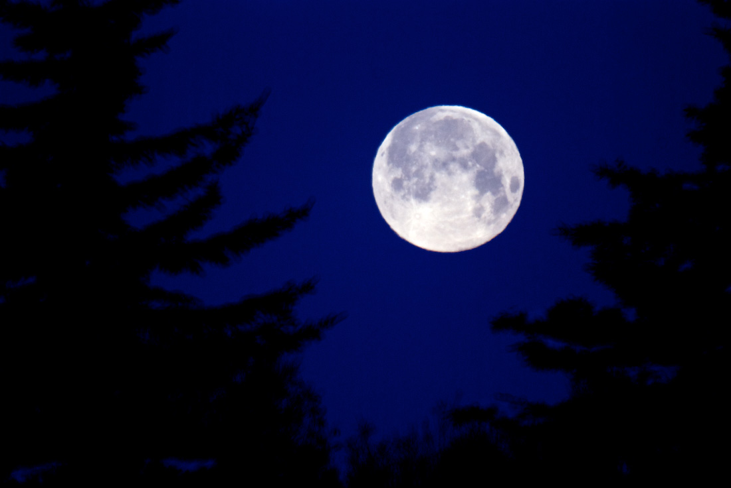
Levels of Spirituality
Dharmis & Karmis
Yogis
Muktas
Bhaktas
Pure Bhaktas

Slide 40
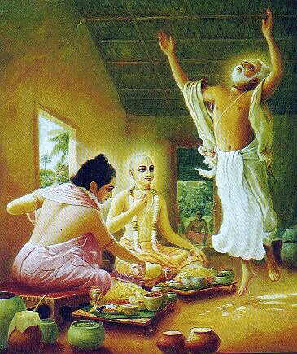
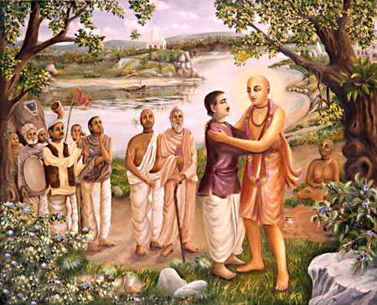

Slide 41
How will be the mindset of Bhaktas?
Nāham vande tava caraņayor
dvandvam advandva-hetoh
Kumbhīpākam gurum api hare
nārakam nāpanetum
Ramyā-rāmā-mrdu-tanu-latā
nandane nāpi rantum
Bhāve bhāve hrdaya-bhavane
bhāvayeyam bhavantam
(Mukunta Mala – Text-4)
"O Lord Hari, I pray to your lotus feet not because to be saved from dualities of material existence (moksha), or to be saved from the grim cruelty of the Kumbhipāka hell. I pray to your lotus feet not for enjoying the soft-skinned beautiful women who reside in the gardens of heaven. I pray to Your lotus feet only so that birth after birth I may remember You alone in the core of my heart. ”

Slide 42
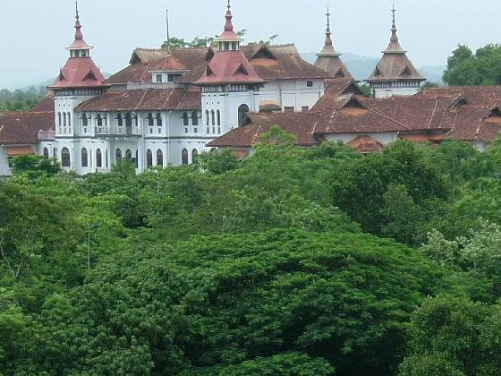

Slide 43
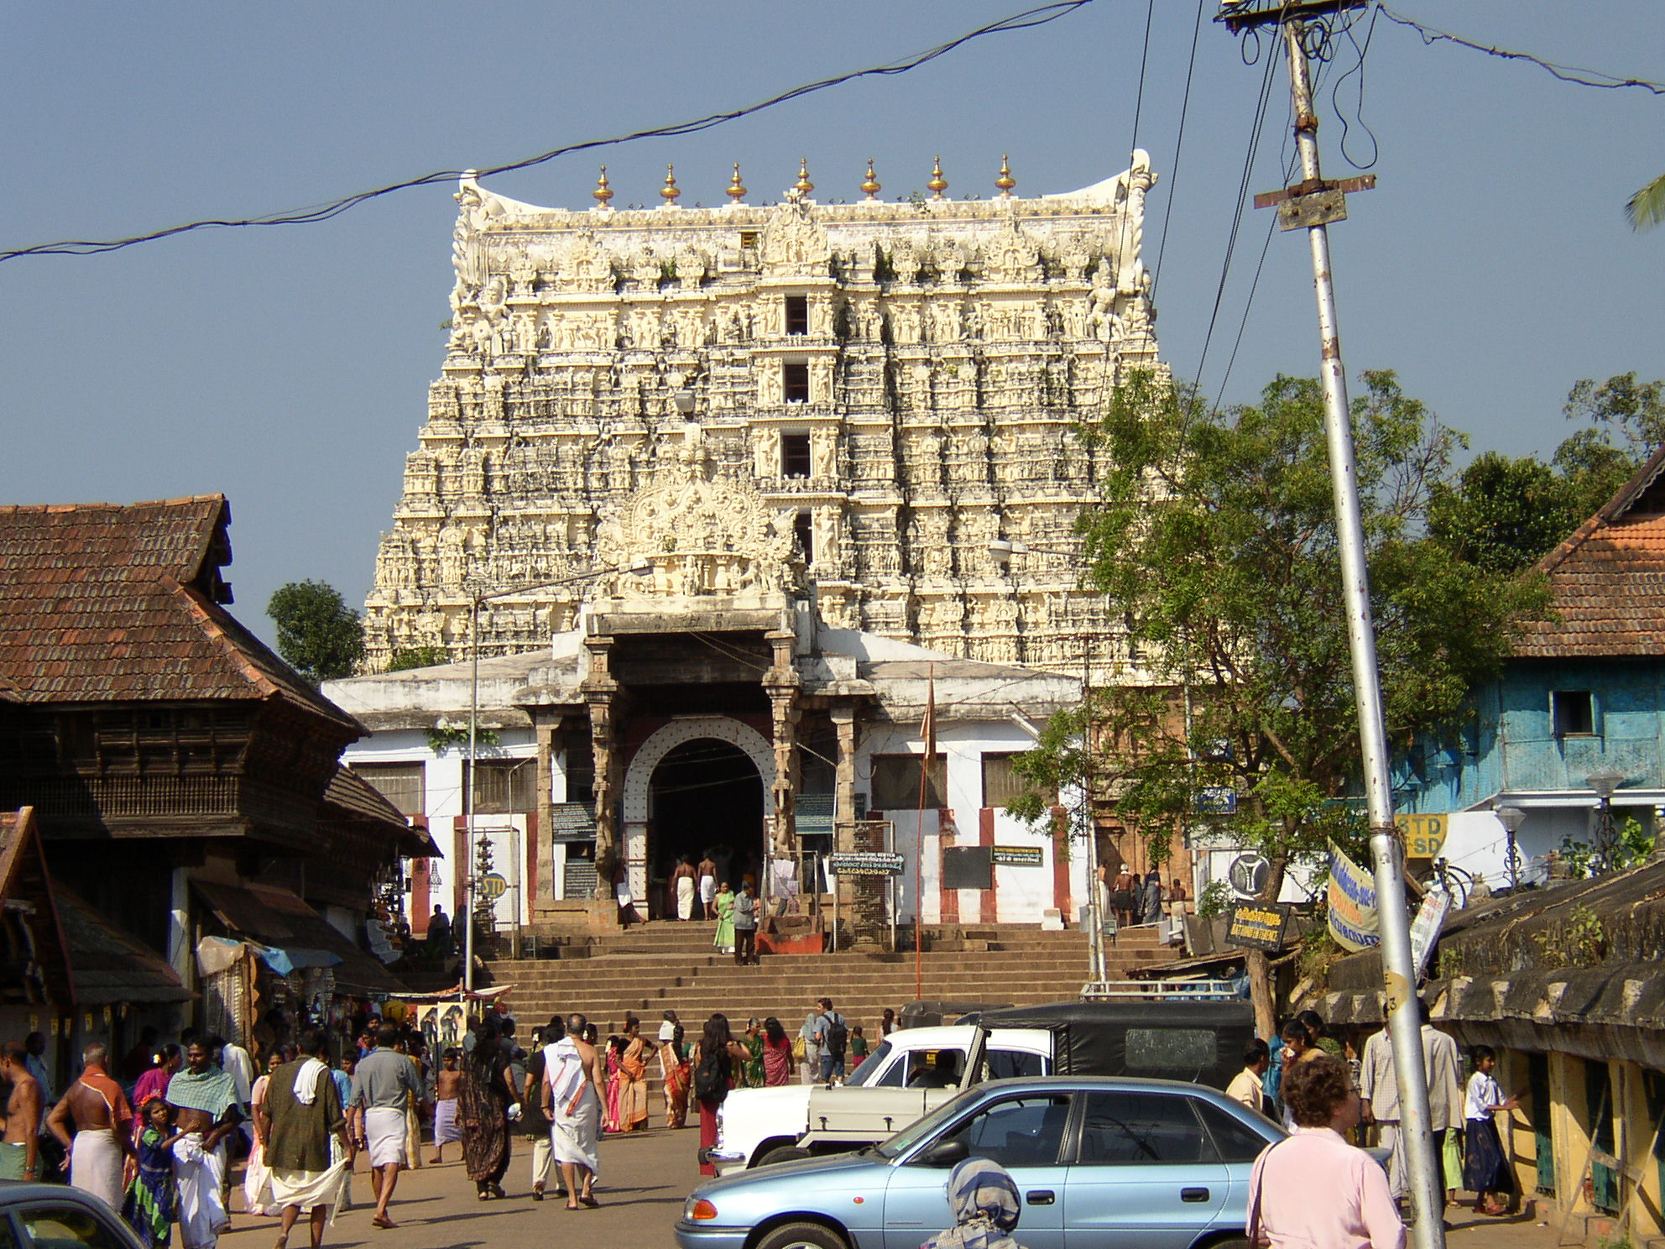
Padmanabhapuram temple, Kerala

Slide 44
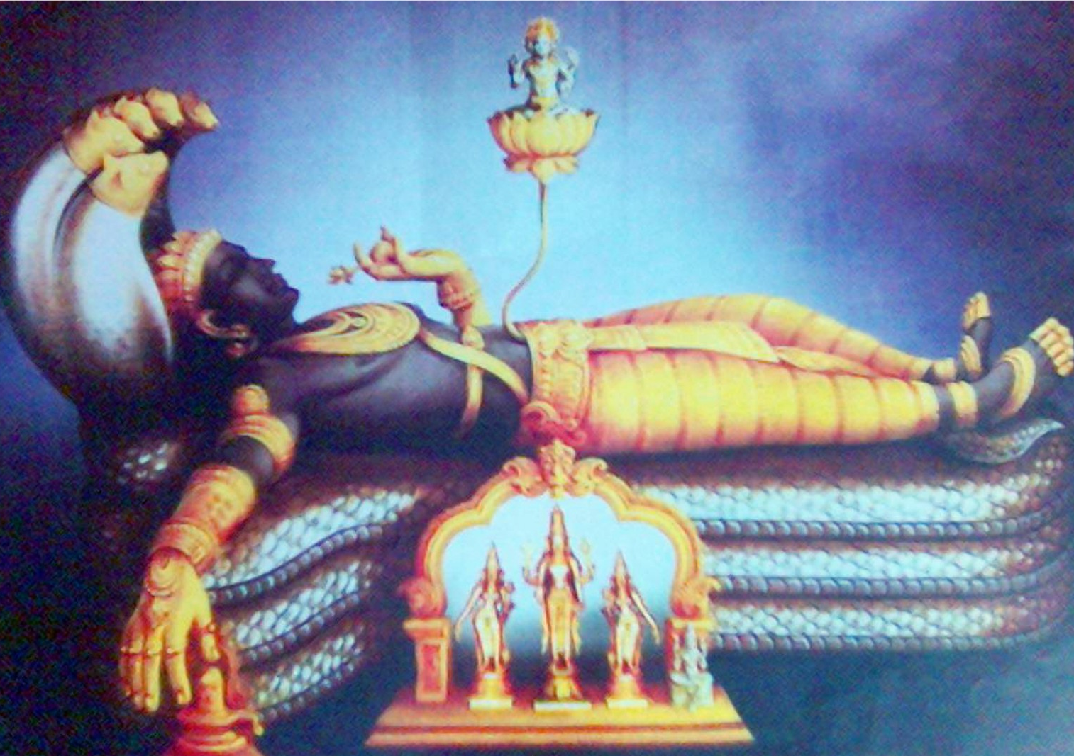

Slide 45
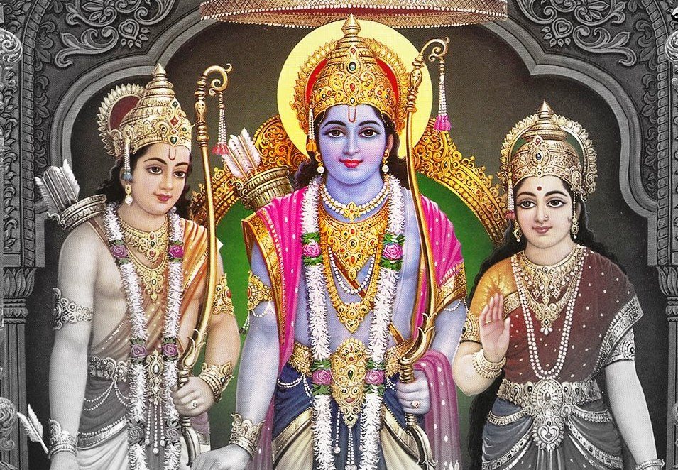
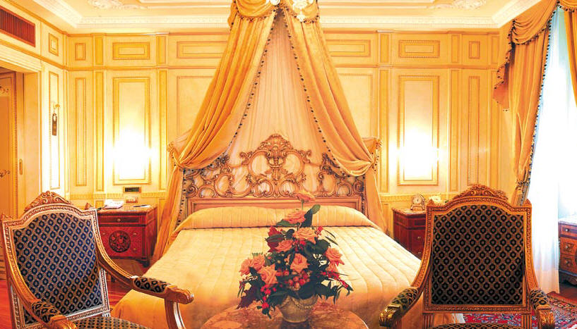

Slide 46
Everyone noticed that the King started behaving differently..
He was interested in meeting with vaishnavas
The ministers made false complaints on the Vaishnavas..

Slide 47
The King could not tolerate accusing faults on the devotees.
He made a firm order!.

Slide 48
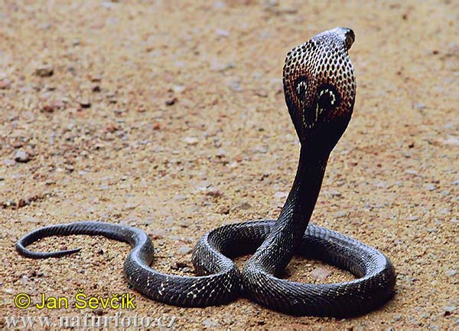

Slide 49
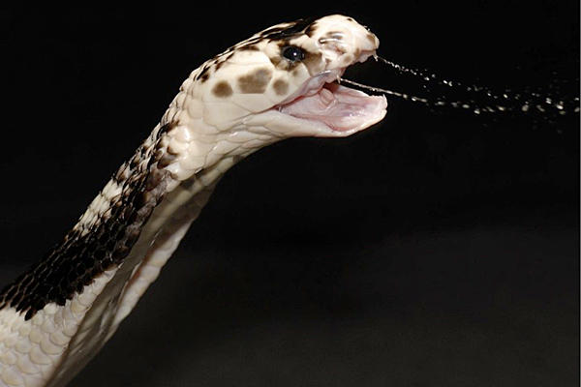

Slide 50
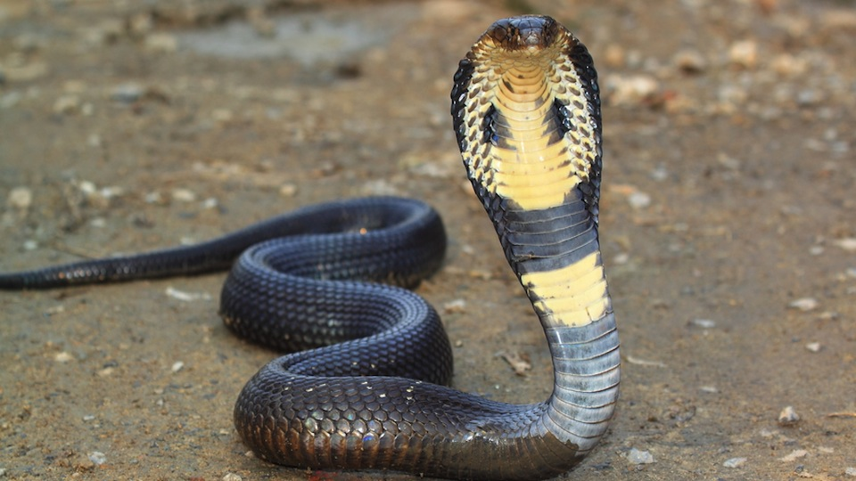
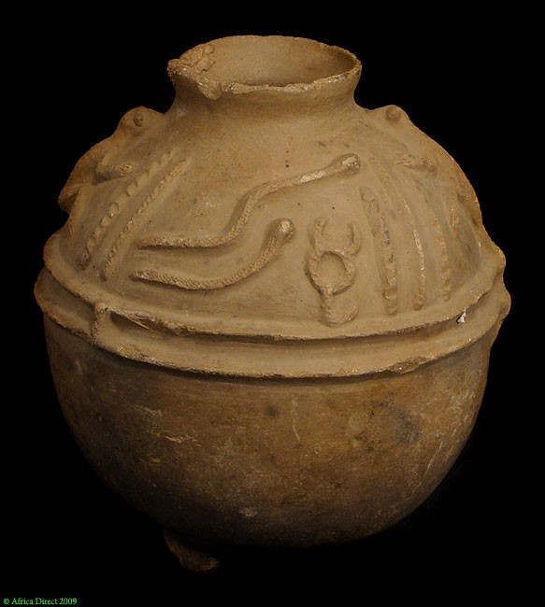

Slide 52
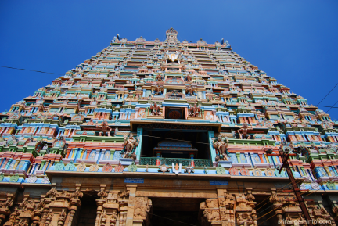
Mukunda Mala
Perumal Thirumozhi

Slide 53
How will be the mindset of Bhaktas?
Nāham vande tava caraņayor
dvandvam advandva-hetoh
Kumbhīpākam gurum api hare
nārakam nāpanetum
Ramyā-rāmā-mrdu-tanu-latā
nandane nāpi rantum
Bhāve bhāve hrdaya-bhavane
bhāvayeyam bhavantam
(Mukunta Mala – Text-4)
"O Lord Hari, I pray to your lotus feet not because to be saved from dualities of material existence (moksha), or to be saved from the grim cruelty of the Kumbhipāka hell. I pray to your lotus feet not for enjoying the soft-skinned beautiful women who reside in the gardens of heaven. I pray to Your lotus feet only so that birth after birth I may remember You alone in the core of my heart. ”

Slide 54
Here is a very common pro verb

Slide 55
The happiness in this material world is like chewing a chewed chewing cum!
Your Happiness is in your hand..!

Slide 57
What is this Happiness we should give?
Giving the souls, an opportunity to get back to Krishna !

Slide 59
Hare Krsna Hare Krsna, Krsna Krsna Hare Hare, Hare Rama Hare Rama, Rama Rama Hare Hare

Slide 60
Thank you!
Hare Krsna
Hare Krsna
Krsna Krsna
Hare Hare
Hare Rama
Hare Rama
Rama Rama
Hare Hare
Catching the Happiness

Slide 62
A-06.1
Kṛpā koro vaiṣṇava ṭhākura,
sambandha jāniyā
Bhajite bhajite, abhimāna hau dūra..
'Āmi to vaiṣṇava', e buddhi hoile,
amānī nā ho'bo āmi
Pratiṣṭhāśā āsi', hṛdoya dūṣibe,
hoibo niraya-gāmī
Tomāra kińkora, āpane jānibo,
'guru'-abhimāna tyaji'
Tomāra ucchiṣṭha, pada-jala-reṇu,
sadā niṣkapaṭe bhaji

Slide 63
A-06.2
Kṛpā koro vaiṣṇava ṭhākura,
sambandha jāniyā
Bhajite bhajite, abhimāna hau dūra..
'Nije śreṣṭha' jāni, ucchiṣṭthādi dāne,
ho'be abhimāna bhāra
Tāi śiṣya tava, thākiyā sarvadā,
nā loibo pūjā kā'ra
Amānī mānada, hoile kīrtane,
adhikāra dibe tumi
Tomāra caraṇe, niṣkapaṭe āmi,
kāńdiyā luṭibo bhūmi

